Slide 1

A Project Review on
Design of Efficient Binary Comparators in Quantum Dot Cellular Automata
Under the guidance of
Mr.P.V.S.R BHARADWAJA.,M.Tech,
Assistant Professor
Department of of E.C.E
Batch No: 1626
K.CHANDUPRIYA 13125A0412
K.MAHESWARA REDDY 13125A0413
B.RAMPRASAD NAIK 13125A0402
N.PRIYANKA 13125A0420
S.K.GOWSHIYA 13125A0423
Department of Electronics And Communication Engineering
SREE VIDYANIKETHAN ENGINEERING COLLEGE (Autonomous)
Sree Sainath nagar, Tirupati – 517102
2012 – 2016

Slide 2
CONTENTS
INTRODUCTION
STRUCTURE OF QCA
QCA BASIC GATES
TYPES OF QCA
CLOCKS IN QCA
COMPARATORS IN QCA
THEOREMS AND COROLLARIES
COMPARATORS USING THEOREMS AND COROLLARIES
COMPARATIVE RESULTS
CONCLUSION
REFERENCES

Slide 3
Introduction
Quantum Dot Cellular Automata (QCA) is an emerging technology suitable for the development of high performance digital circuits.
QCA is mainly directed towards arithmetic circuits.
The potential advantage of QCA includes high speed, reduced overall area and low power dissipation.

Slide 4
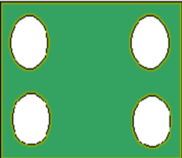
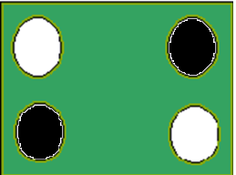
Structure of QCA
The basic element of QCA is a square cell with four quantum dots and two free electrons.
The logic unit in QCA is the QCA cell.
Quantum dot
Electron
fig: Basic QCA cell

Slide 5
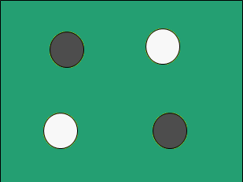
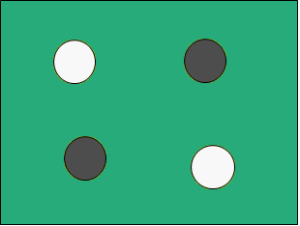




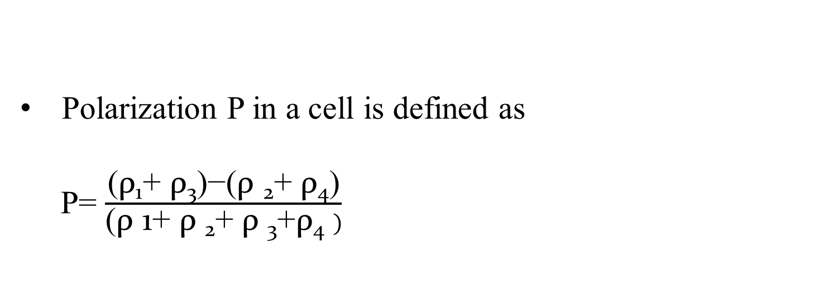
Polarization P in a cell is defined as
P= $\frac{\text{(}\text{ρ}\text{1}\text{+} \text{ρ}\text{3}\text{)−(}\text{ρ} \text{2}\text{+} \text{ρ}\text{4}\text{)}}{\text{(}\text{ρ} \text{1}\text{+} \text{ρ} \text{2}\text{+} \text{ρ} \text{3}\text{+}\text{ρ}\text{4} )}$
$$\text{ρ} \text{4}$$
$$\text{ρ}\text{1}$$
$$\text{ρ}\text{2}$$
$$\text{ρ}\text{3}$$
“Logic 0” “Logic 1”
Polarization -1 polarization +1
Fig : Binary QCA cells

Slide 6
QCA Basic Gates
Majority Gate
Inverter
Binary Wire
Inverter chain

Slide 7
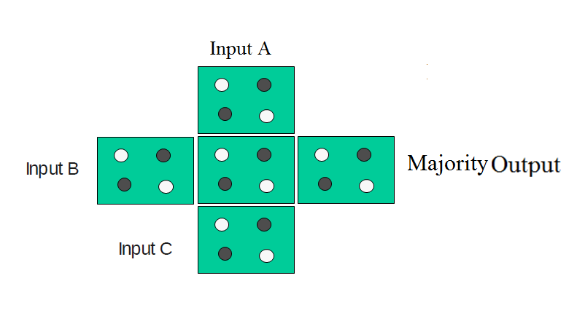
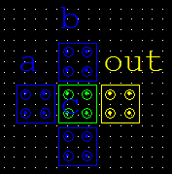
Majority Gate
Fig: Majority Gate
Fig: Majority Gate using QCA Designer

Slide 8
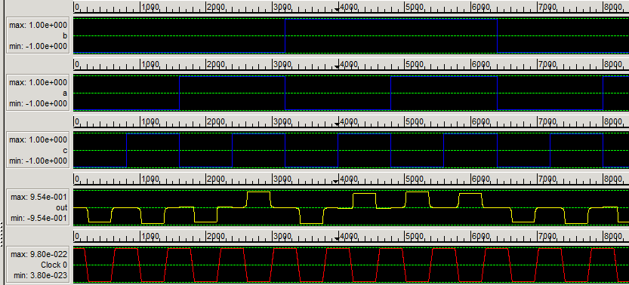
Majority Gate output
Fig: Output of Majority gate using QCA Designer

Slide 9
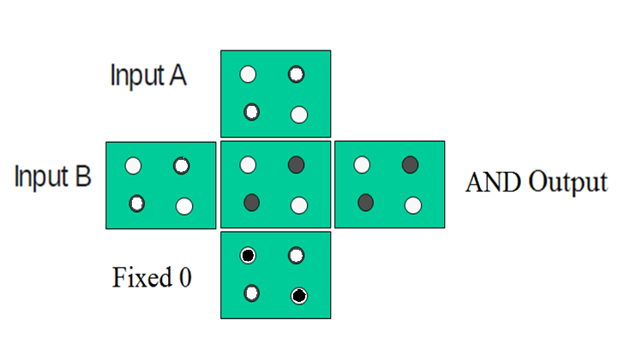
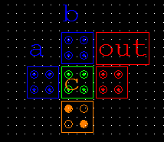
Majority AND gate
Fig: AND Gate using QCA
Fig: Design of AND gate

Slide 10
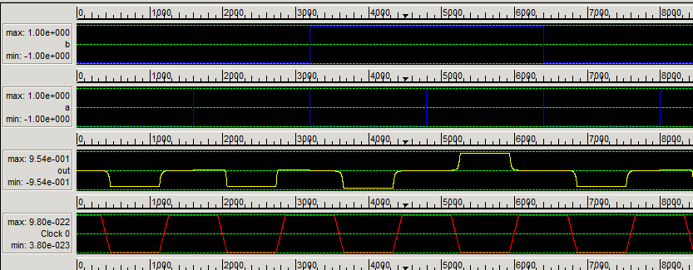
Majority AND Gate output
Fig :Output of Majority AND Gate using QCA Designer

Slide 11
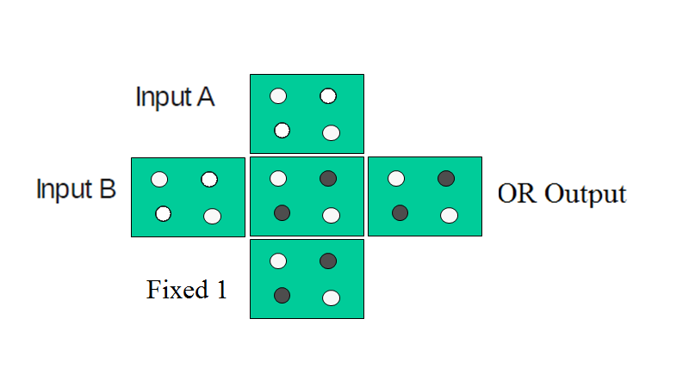
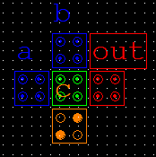
Majority OR gate
Fig: Design of OR gate
gverFig: OR Gate using QCA

Slide 12
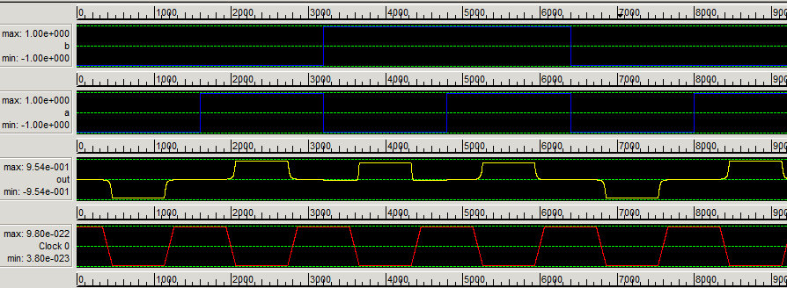
Majority OR Gate output
Fig: Output of Majority OR Gate using QCA Designer

Slide 13
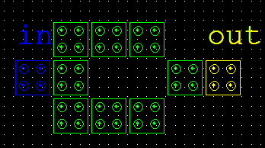
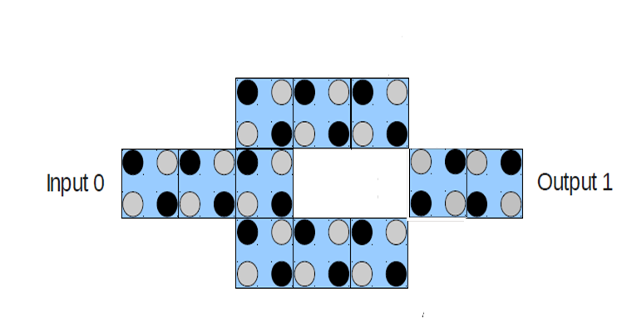

Inverter
Fig: Structure of Inverter in QCA
Fig : Inverter using QCA Designer

Slide 14
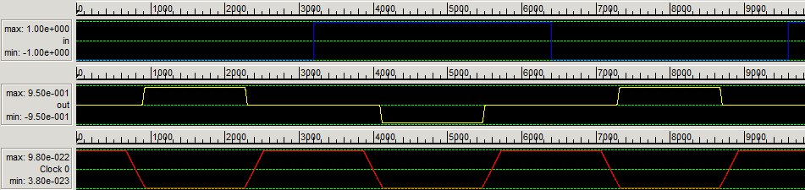
Inverter output
Fig: Output of Inverter using QCA Designer

Slide 15
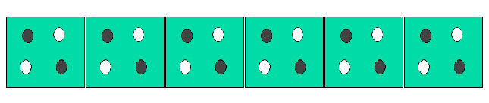
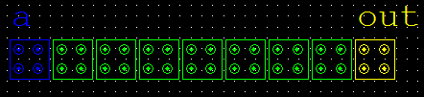
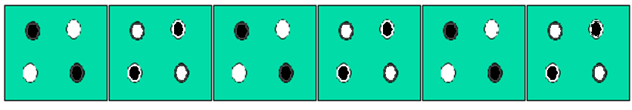

BINARY WIRE
Fig: Binary wire
INVERTER CHAIN
Fig: Inverter chain

Slide 16
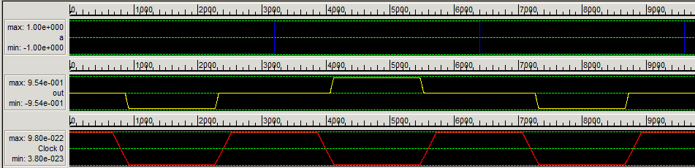
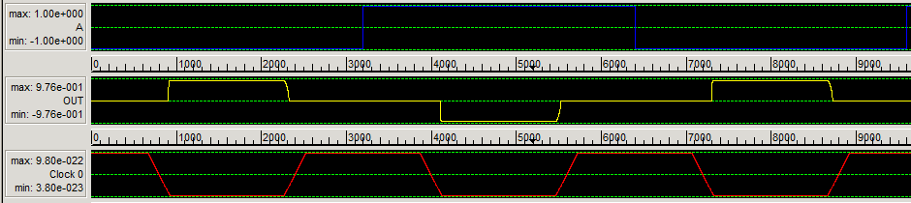
Binary wire output Inverter chain output
Fig: Output of Binary wire using QCA Designer
Fig: Output of Inverter chain using QCA Designer

Slide 17
Types of QCA
Metal-Island
Semiconductor QCA
Molecular QCA
Magnetic QCA

Slide 18
Clocks in QCA
These clock signals are supplied by CMOS wires or CNT’s buried under the QCA circuitry.
QCA designs rely on a set of 4 clocks, phase shifted with respect to each other.
Clock is used to push information from inputs to the output by modifying the cell tunnelling energy. QCA circuits have a four phase clock .

Slide 19
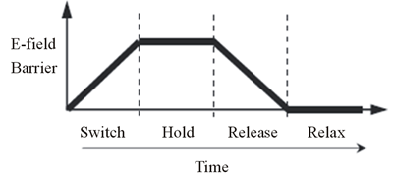
Four phases of clock in QCA
Fig: Four phases of clock

Slide 20
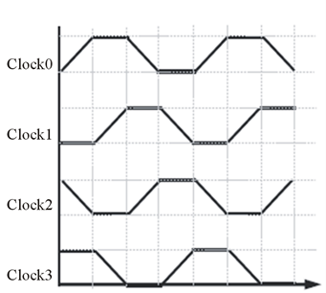
Clocking schemes
Fig: clock signals in four clocking zones

Slide 21
Comparators in QCA
QCA implementations are mainly provided for comparing two single bits.
There are two types of comparators in QCA .
Non-full comparators
Full comparator
1- bit binary comparator receives two bits a and b and establishes whether they are equal, or less than or greater than each other.

Slide 22
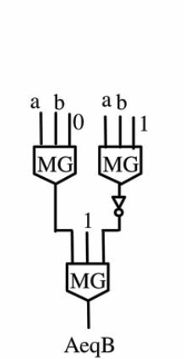
Non full comparators^{[2]}
Non full comparators recognize either one or two of a>b, a<b, and a=b.
1
1
1
1
Fig: Non full comparators

Slide 23
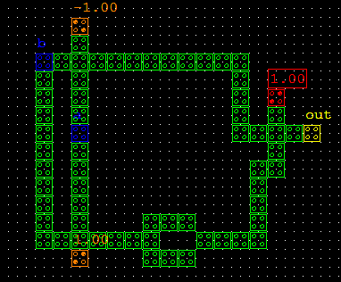
Layout of Non full comparator
Fig: Non full comparator using QCA Designer

Slide 24
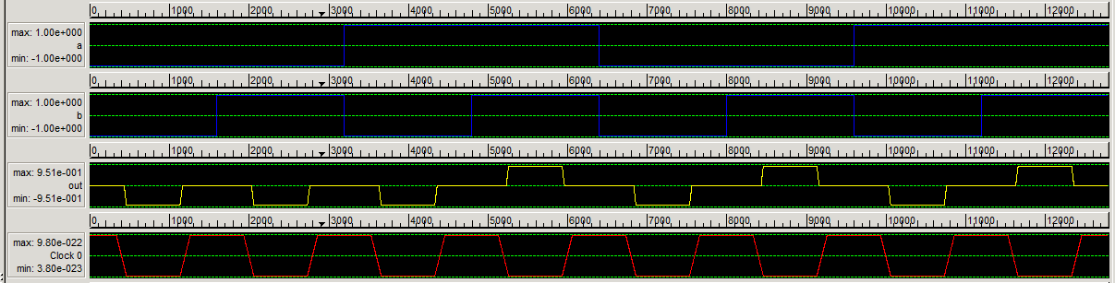
Non full comparator output
Fig: Output of Non full comparator using QCA Designer

Slide 25
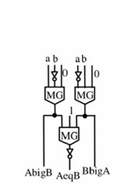
Full Comparators^{[3]}
Full comparators separately identify the all i.e., a=b, a>b, a<b.
1
0
1
0
Fig: Full comparator

Slide 26
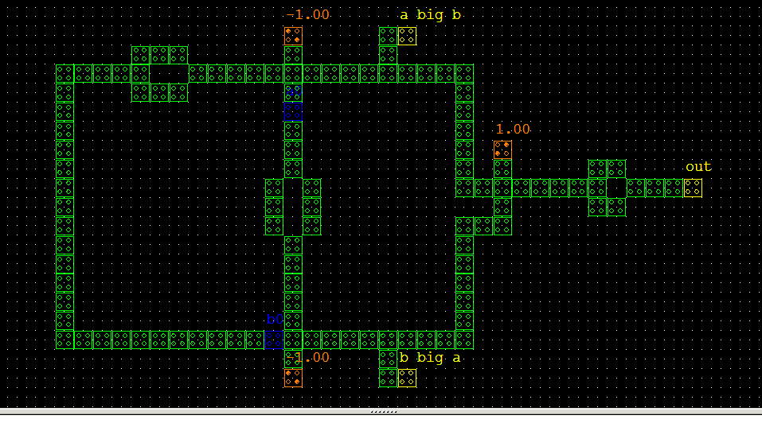
Layout of Full comparator in QCA
Fig : Full comparator using QCA Designer

Slide 27
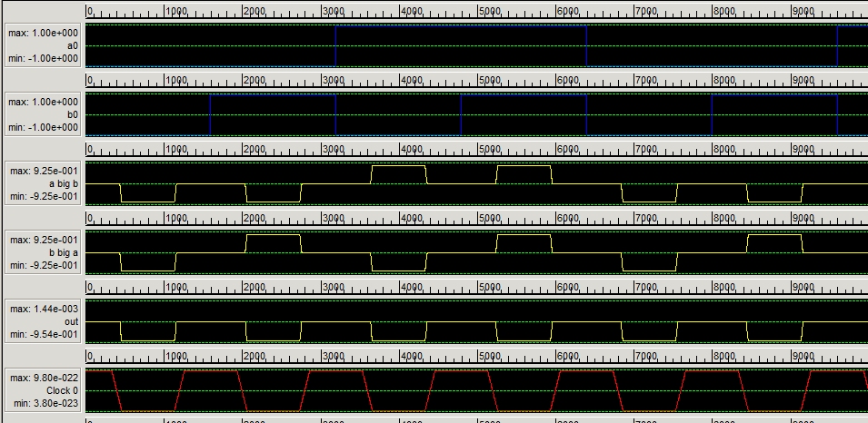
Full comparator output
Fig: output of Full comparator using QCA Designer

Slide 28
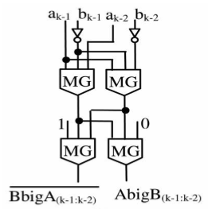

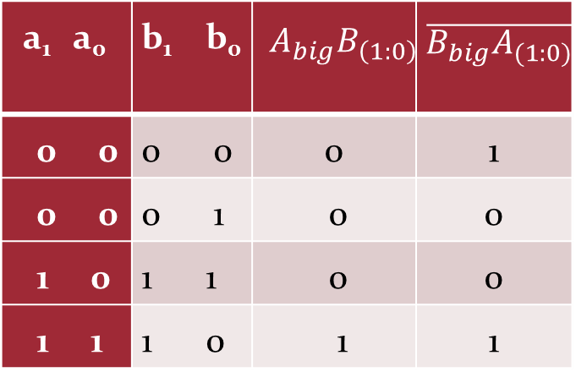
THEOREMS & COROLLARIES
Theorem 1
${ A}_{big}B_{\left(k−1:k−2\right)}=M\left(a_{k−1},\overline{b_{k−1}},a_{k−2}\right).M\left(a_{k−1},\overline{b_{k−1}},\overline{b_{k−2}}\right)$
$\overline{B_{big}A_{(k−1:k−2)}}=M\left(a_{k−1},\overline{b_{k−1}},a_{k−2}\right)+M\left(a_{k−1},\overline{b_{k−1}},\overline{b_{k−2}}\right)$
TrTruth table
a₁ a₀ | b₁ b₀ | $${ A}_{big}B_{\left(1:0\right)}$$ | $$\overline{B_{big}A_{(1:0)}}$$
0 0 | 0 0 | 0 | 1
0 0 | 0 1 | 0 | 0
1 0 | 1 1 | 0 | 0
1 1 | 1 0 | 1 | 1
Ffig : Theorem 1 circuit

Slide 29
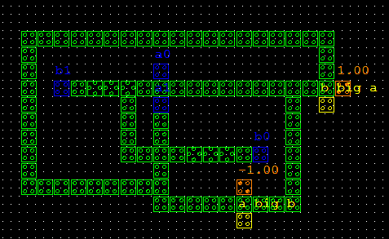
Theorem 1 Layout
Fig: Theorem 1 using QCA Designer

Slide 30
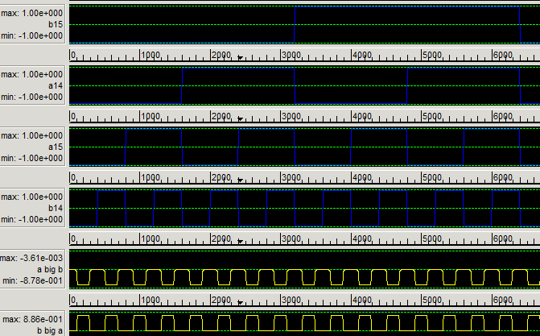
Theorem 1 output
Fig: Output of Theorem 1 using QCA Designer

Slide 31

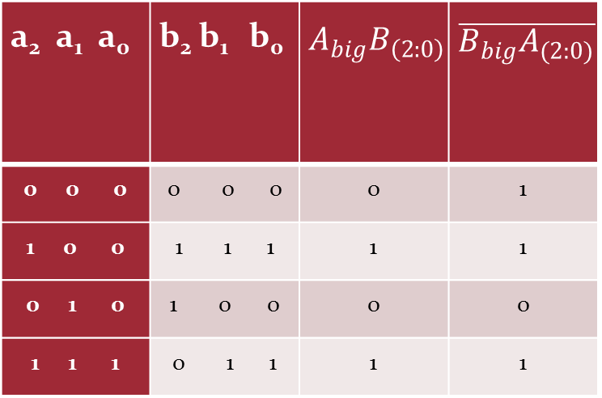
Theorem 2
$A_{big}B_{\left(K−1:K−3\right)}=M( M\left(a_{k−1},\overline{b_{k−1}},a_{k−2}\right), M\left(a_{k−1},\overline{b_{k−1}},\overline{b_{k−2}}\right),a_{k−3}. \overline{b_{k−3}})$
$\overline{B_{big}A_{(k−1:k−3)}}=M\left({M(a}_{k−1},\overline{b_{k−1}},a_{k−2}\right),M\left(a_{k−1},\overline{b_{k−1}},\overline{b_{k−2}}\right) , a_{k−3}+\overline{b_{k−3}}$ ).
Truth table
a₂ a₁ a₀ | b₂ b₁ b₀ | $$A_{big}B_{\left(2:0\right)}$$ | $$\overline{B_{big}A_{(2:0)}}$$
0 0 0 | 0 0 0 | 0 | 1
1 0 0 | 1 1 1 | 1 | 1
0 1 0 | 1 0 0 | 0 | 0
1 1 1 | 0 1 1 | 1 | 1
Fig: Therem 2 circuit

Slide 32
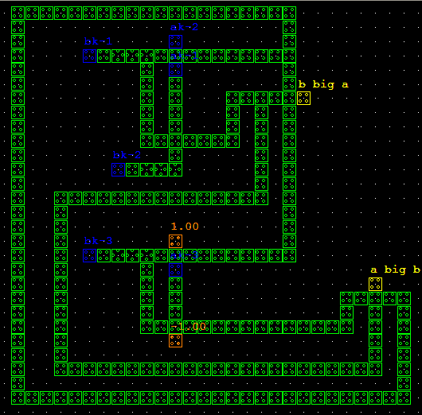
Theorem 2 Layout
Fig: Theorem 2 using QCA Designer

Slide 33
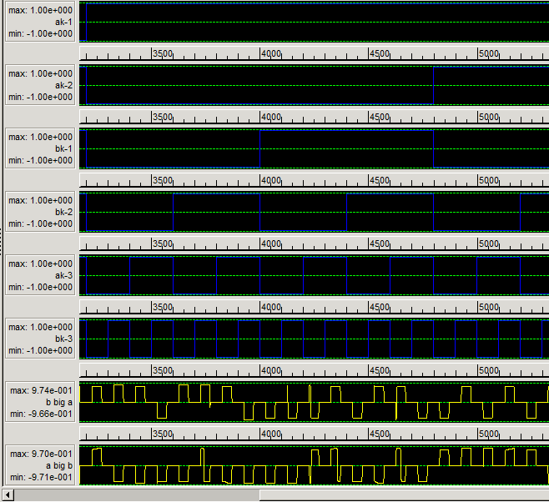
Theorem 2 output
Fig: Output of Theorem 2 using QCA Designer

Slide 34

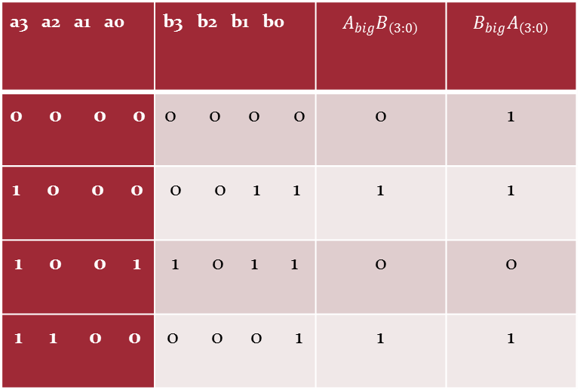
Theorem 3
$A_{big}B_{\left(n−1:0\right)=} M\left({M(a}_{n−1},\overline{b_{n−1}},a_{n−2}\right), M\left(a_{n−1},\overline{b_{n−1}},\overline{b_{n−2}}\right),A_{big}B_{\left(n−3:0\right)})$
$\overline{B_{big}A_{(n−1:0)}}=M\left({M(a}_{n−1},\overline{b_{n−1}},a_{n−2}\right),M\left(a_{n−1},\overline{b_{n−1}},\overline{b_{n−2}}\right) ,\overline{B_{big}A_{(n−3:0)}}$ )
Truth table
a3 a2 a1 a0 | b3 b2 b1 b0 | $$A_{big}B_{\left(3:0\right)}$$ | $$B_{big}A_{\left(3:0\right)}$$
0 0 0 0 | 0 0 0 0 | 0 | 1
1 0 0 0 | 0 0 1 1 | 1 | 1
1 0 0 1 | 1 0 1 1 | 0 | 0
1 1 0 0 | 0 0 0 1 | 1 | 1
fffFig: Theorem 3 circuit

Slide 35
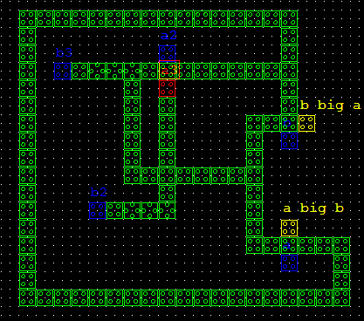
Theorem 3 Layout
Fig: Theorem 3 using QCA Designer

Slide 36
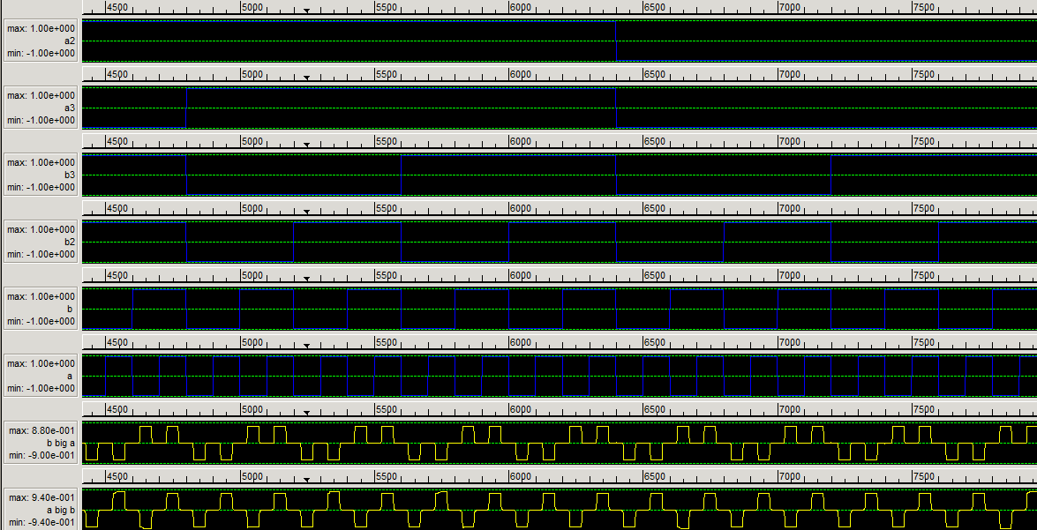
Theorem 3 output
Fig: Output of Theorem 3 using QCA Designer

Slide 37

THEOREM 4
$A_{big}B_{(n−1:0)}$=M($A_{big}B_{\left(n−1:n−3\right),}\overline{B_{big}A_{\left(n−1:n−3\right),}}$ AbigB_{(n−4:0)})
$\overline{B_{big}A_{(n−1:0)}}=$ M($A_{big}B_{\left(n−1:n−3\right),}\overline{B_{big}A_{\left(n−1:n−3\right),}}$ $\overline{B_{big}A_{(n−4:0)}}$ )
Fig: Theorem 4 circuit

Slide 38
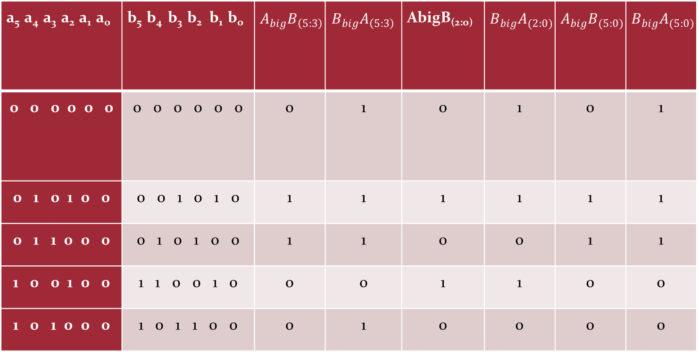
Theorem 4 Truth table
a₅ a₄ a₃ a₂ a₁ a₀ | b₅ b₄ b₃ b₂ b₁ b₀ | $$A_{big}B_{\left(5:3\right)}$$ | $$B_{big}A_{\left(5:3\right)}$$ | AbigB_{(2:0)} | $$B_{big}A_{(2:0)}$$ | $$A_{big}B_{(5:0)}$$ | $$B_{big}A_{(5:0)}$$
0 0 0 0 0 0 | 0 0 0 0 0 0 | 0 | 1 | 0 | 1 | 0 | 1
0 1 0 1 0 0 | 0 0 1 0 1 0 | 1 | 1 | 1 | 1 | 1 | 1
0 1 1 0 0 0 | 0 1 0 1 0 0 | 1 | 1 | 0 | 0 | 1 | 1
1 0 0 1 0 0 | 1 1 0 0 1 0 | 0 | 0 | 1 | 1 | 0 | 0
1 0 1 0 0 0 | 1 0 1 1 0 0 | 0 | 1 | 0 | 0 | 0 | 0

Slide 39
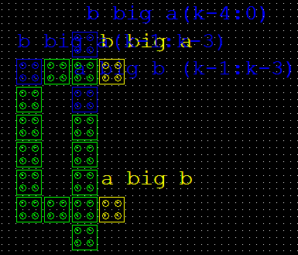
Theorem 4 Layout
Fig: Theorem 4 using QCA Designer

Slide 40
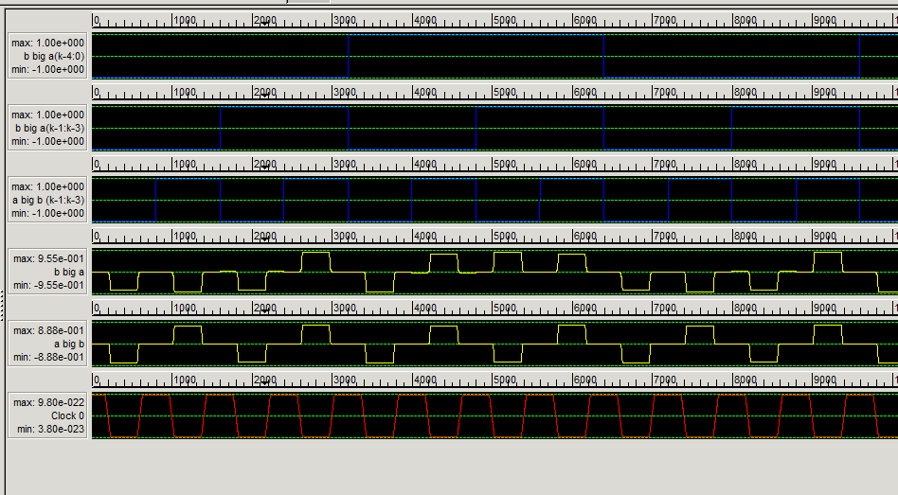
Theorem 4 output
Fig: Output of theorem 4 using QCA designer

Slide 41

Corollary 1
$A_{big}B_{(n−1:0)}$=M($A_{big}B_{\left(n−1:h\right),}\overline{B_{big}A_{\left(n−1:h\right),}}$ Abig$B_{(h−1:0)}$
$\overline{B_{big}A_{(n−1:0)}}=$ M($A_{big}B_{\left(n−1:h\right),}\overline{B_{big}A_{\left(n−1:h\right),}}$ $\overline{B_{big}A_{(h−1:0)}}$ )
Fig: Corollary 1 circuit

Slide 42
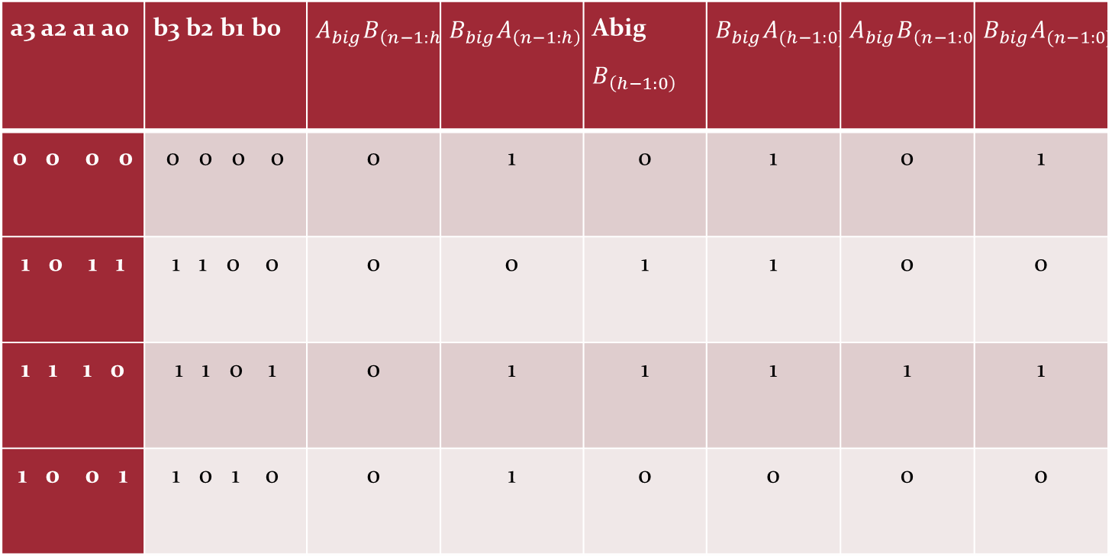
Corollary 1 Truth table
a3 a2 a1 a0 | b3 b2 b1 b0 | $$A_{big}B_{\left(n−1:h\right)}$$ | $$B_{big}A_{\left(n−1:h\right)}$$ | Abig$B_{\left(h−1:0\right)}$ | $$B_{big}A_{(h−1:0)}$$ | $$A_{big}B_{\left(n−1:0\right)}$$ | $$B_{big}A_{(n−1:0)}$$
0 0 0 0 | 0 0 0 0 | 0 | 1 | 0 | 1 | 0 | 1
1 0 1 1 | 1 1 0 0 | 0 | 0 | 1 | 1 | 0 | 0
1 1 1 0 | 1 1 0 1 | 0 | 1 | 1 | 1 | 1 | 1
1 0 0 1 | 1 0 1 0 | 0 | 1 | 0 | 0 | 0 | 0

Slide 43
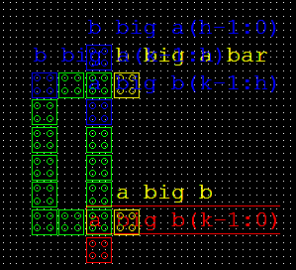
Corollary 1 Design
Fig: Corollary 1 using QCA Designer

Slide 44
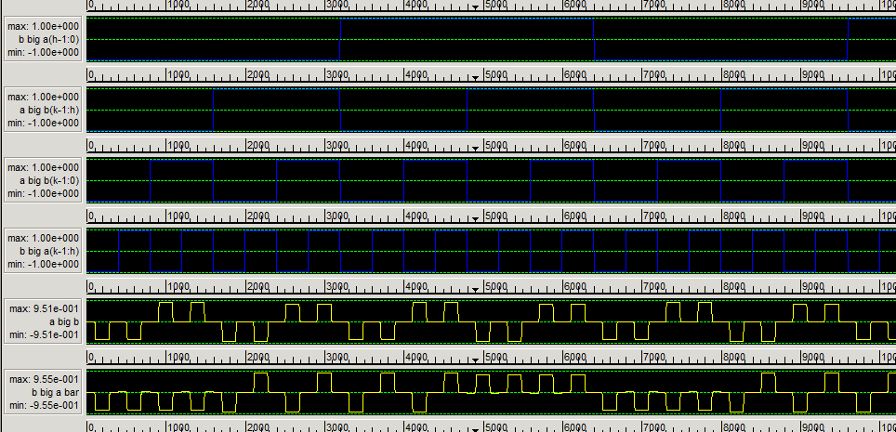
Corollary 1 output
Fig : Output of corollary 1 using QCA Designer

Slide 45


Corollary 2
A eq B(n−1:0)= M($\overline{A_{big}B_{(n−1:0)}}$) , $\overline{B_{big}A_{(n−1:0)}}$ ,0)
Truth table
a5 a4 a3 a2 a1 a0 | b5 b4 b3 b2 b1 b0 | $\overline{A_{big}B_{(n−1:0)}}$) | $$\overline{B_{big}A_{(n−1:0)}}$$ | A eq B(n−1:0)
0 0 0 0 0 0 | 0 0 0 0 0 0 | 0 | 1 | 1
0 1 1 0 0 0 | 0 1 0 1 0 0 | 1 | 1 | 0
1 0 0 0 0 0 | 1 0 0 1 0 1 | 0 | 0 | 0
1 1 0 1 1 0 | 1 1 1 1 0 1 | 0 | 0 | 0
0 1 1 0 0 0 | 0 1 1 0 0 0 | 0 | 1 | 1

Slide 46

Corollary 2 Layout
Fig: Corollary 2 using QCA Designer
Fig: Corollary 2 circuit

Slide 47

Corollary 2 output
Fig : Output of Corollary 2 using QCA Designer

Slide 48

Comparators using Theorems & Corollaries
Novel 16-bit Comparator
Fig : Novel 16-bit comparator circuit

Slide 49

Novel 16-bit comparator Layout
Fig: 16-bit comparator using QCA Designer

Slide 50

Novel 16-bit comparator output
Fig: Output of novel comparator using QCA Designer

Slide 51

Novel 32-bit CB Full comparator
Fig: Novel 16-bit CB full comparator circuit

Slide 52

Novel 32-bit CB Full comparator Layout
Fig: Design of 32-bit CB full comparator using QCA Designer

Slide 53

Novel 32-bit CB Full comparator output
Fig: Output of Novel 32-bit CB comparator using QCA Designer

Slide 54

Novel 32-bit TB comparator
Fig: Novel 32-bit TB comparator circuit

Slide 55

Novel 32-bit TB comparator Layout
Fig: Design of Novel 32-bit TB comparator using QCA Designer

Slide 56

Novel 32-bit TB comparator output
Fig: Output of Novel 32-bit TB comparator using QCA Designer

Slide 57

Comparative Results
Delay values

Slide 58

Graphical representation
Fig: Graphical representation of comparative results

Slide 59
Area Requirements
Comparator | Majority gates | Inverters | No. of cells | Area
Non full comparator | 3 | 1 | 29 | 41201.67 nm²
Full comparator | 3 | 3 | 119 | 278294.00 nm²
16-bit comparator | 55 | 17 | 2283 | 5204906.63 nm²
32-bit novel TB comparator | 83 | 33 | 6009 | 16801764.00 nm²
32-bit novel CB comparator | 87 | 34 | 5784 | 14723247.02 nm²

Slide 60
Applications of QCA
Since QCA supports faster interconnections and lesser power consumption it is used in many applications.
For display technology
Used to design memories and shift registers
Used in high frequency applications
Logic elements

Slide 61
Conclusion
QCA is based on innovative formulations that allow increased speed performances and reduced overall sizes to be achieved with respect to the existing competitors. To over come the problems of the present comparators new theorems for comparators are needed.

Slide 62
References
[1] Stefania Perri, Pasquale Corsonello, Giuseppe Cocorullo,”Design of
efficient binary comparators in Quantum-Dot Cellular Automata”,
IEEE Transactions on Nano Technology. Vol.13,No.2,March 2014.
[2] J. R. Janulis, P. D. Tougaw, S. C. Henderson, and E. W. Johnson,
“Serial bit-stream analysis using quantum-dot cellular automata,”
IEEE Trans.Nanotechnol., vol. 3, no. 1, pp. 158–164, Mar. 2004.
[3] K. Qiu andY. Xia, “Quantum-dots cellular automata comparator,” in
Proc.Int. Conf. ASIC, pp. 1297–1300, 2007.
[4] Y. Xia and K. Qiu, “Comparator design based on quantum-dot
cellular automata,” J. Electron. Inf. Technol., vol. 31, no. 6, pp. 1517–
1520, 2009.

Slide 63
THANK YOU

